Slide 1
Country Discovery
Application
Let’s exploring and learning about other countries around the world!
Notes:
Presentation skills (2 marks)

Slide 2
01
Persona
Notes:
Describe the target audience (2 marks)
Explain what problem is being solved (2 marks)
Explain/demonstrate how your app compares to other possible solutions (2 marks)

Slide 3

Target Audience
Problem to solve
Tom - 23 years old
Young adult (18-26 years old) who is curious to know and learn about other countries information.
It’s difficult to find an application that provides all information about the country (flag, map, currency, language, sub region, capital, population)
"While I enjoy travelling, there are times when I lack knowledge about the places I want to see."
Notes:
Describe the target audience (2 marks)
Explain what problem is being solved (2 marks)

Slide 4
02
Prototype
Using Figma (High-fidelity Prototype)
Notes:
Demonstrate how you achieve minimum viable product by following an iterative product design cycle (1 mark)
Demonstrate the greatest difficulty you encountered and how you solved it, in coding or design (2 marks)
Explain what frameworks/services you used to solve the problem (2 marks)

Slide 5
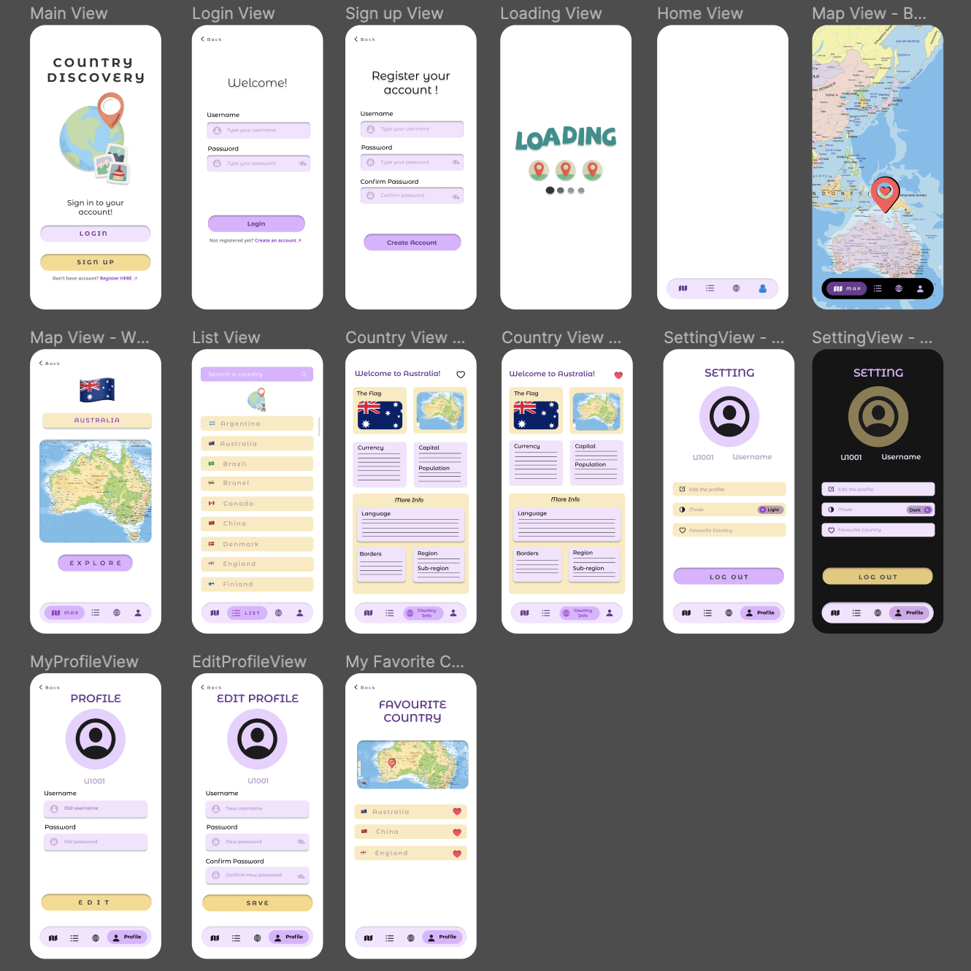
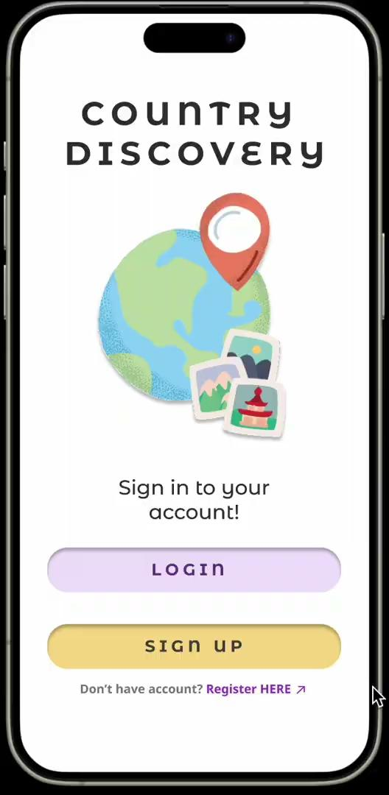
https://drive.google.com/file/d/1BeatrsTeeOtxfrNJlLUIP6uVBgCQjWLT/view?usp=drive_link - video
Notes:
State what is our problem during coding and design in this slide and how we solve it.
Demonstrate the greatest difficulty you encountered and how you solved it, in coding or design (2 marks)
Explain what frameworks/services you used to solve the problem (2 marks)
https://drive.google.com/file/d/1BeatrsTeeOtxfrNJlLUIP6uVBgCQjWLT/view?usp=drive_link - video

Slide 6
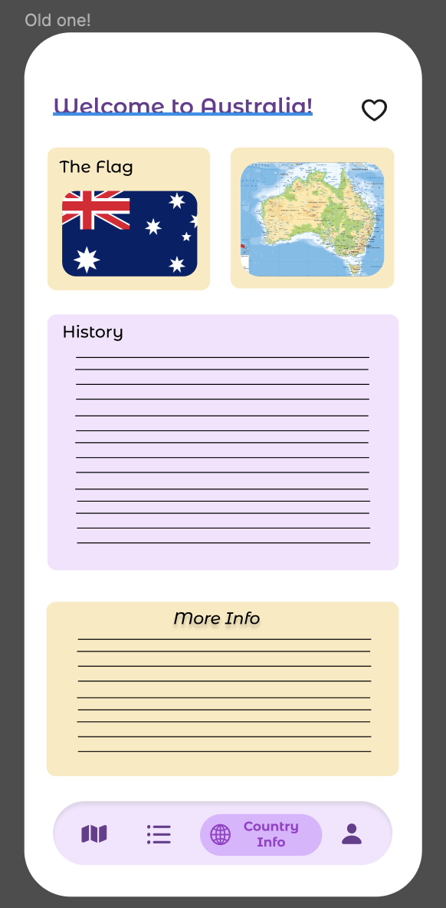
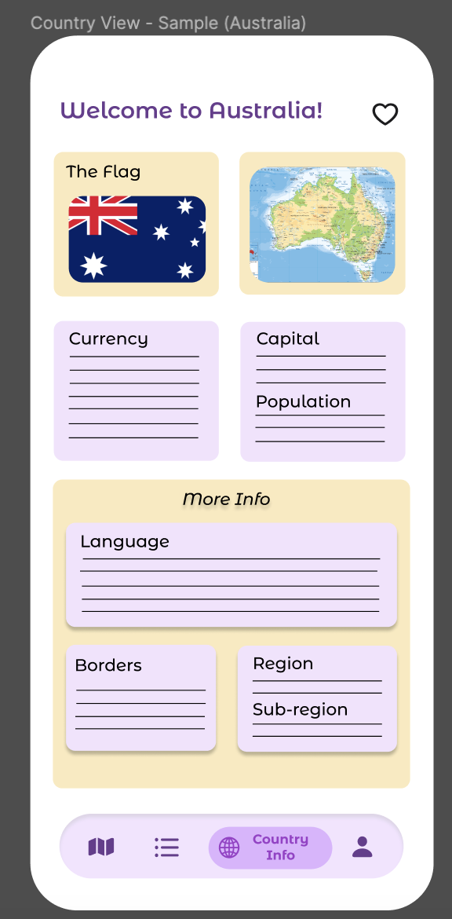
Obtain Feedback and Improve
dividing the information into the smaller boxes
https://www.figma.com/design/SqJmnCisLAqoJeYkQffgq7/Countries-Discovery-Apps?node-id=0%3A1&t=6kHUa4zfRKlBEQbw-1
Notes:
Demonstrate how you achieve minimum viable product by following an iterative product design cycle (1 mark)
Improve our screen by dividing the information into the smaller boxes so that it is easy to understand by the user.
Remove the map so that the list of favourite country becomes more clear
Integrate this screen to the Map View so it will improve the efficiency and easiness of the application

Slide 7
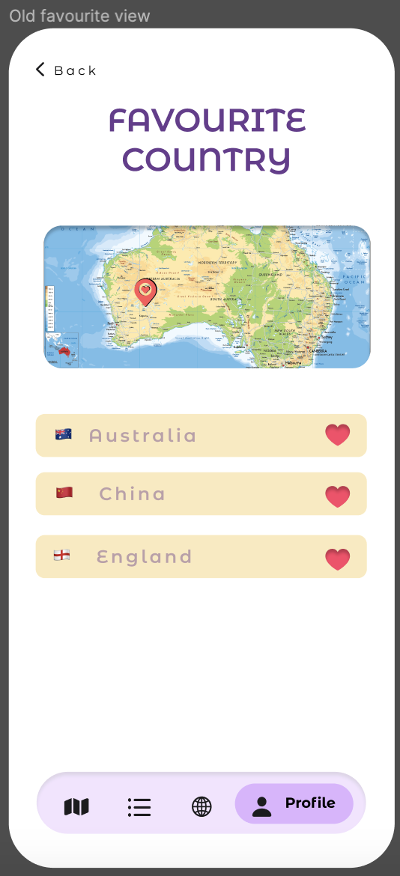
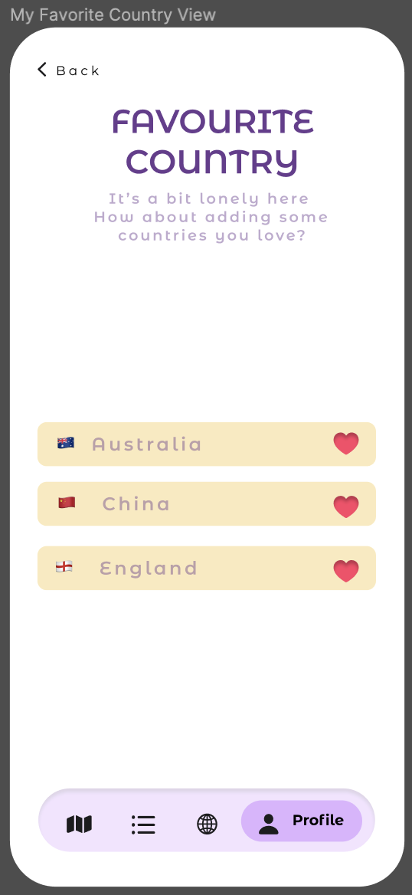
Obtain Feedback and Improve
Remove the map in the favourite country view
https://www.figma.com/design/SqJmnCisLAqoJeYkQffgq7/Countries-Discovery-Apps?node-id=0%3A1&t=6kHUa4zfRKlBEQbw-1
Notes:
Demonstrate how you achieve minimum viable product by following an iterative product design cycle (1 mark)
Improve our screen by dividing the information into the smaller boxes so that it is easy to understand by the user.
Remove the map so that the list of favourite country becomes more clear
Integrate this screen to the Map View so it will improve the efficiency and easiness of the application

Slide 8
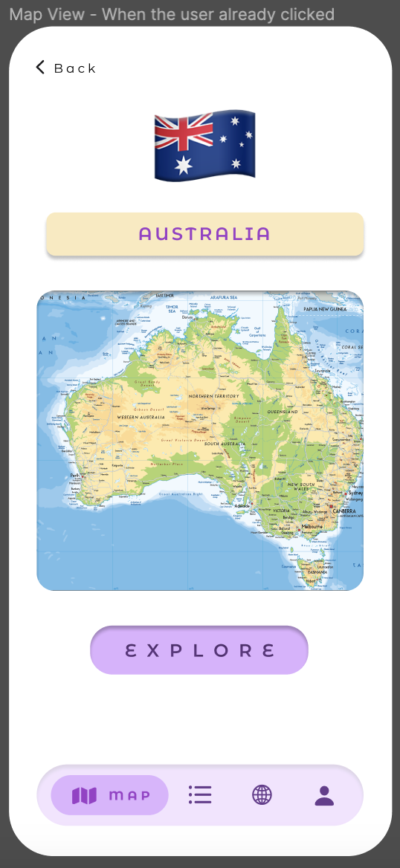
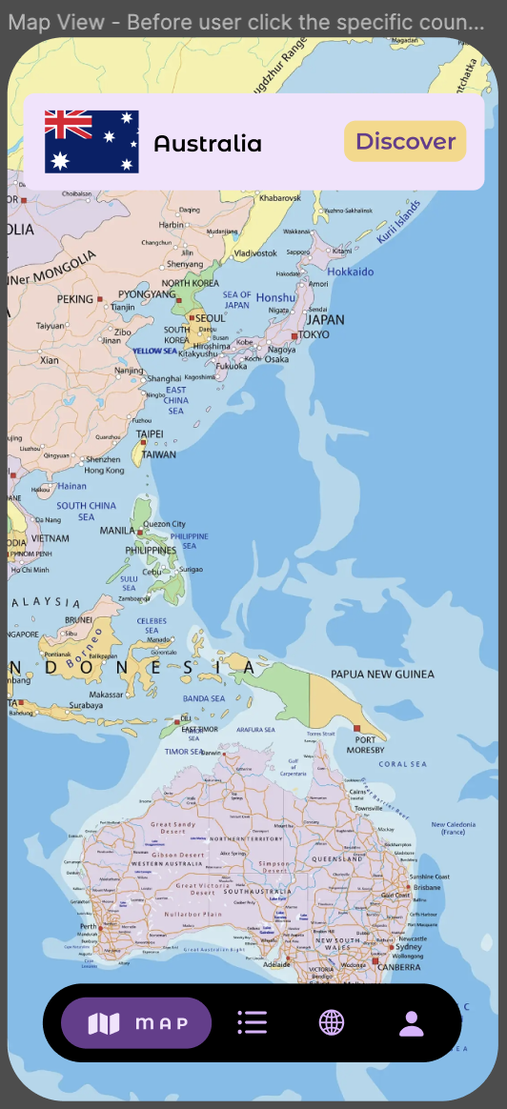
Obtain Feedback and Improve
Integrate this screen to the Map view
https://www.figma.com/design/SqJmnCisLAqoJeYkQffgq7/Countries-Discovery-Apps?node-id=0%3A1&t=6kHUa4zfRKlBEQbw-1
Notes:
Demonstrate how you achieve minimum viable product by following an iterative product design cycle (1 mark)
Improve our screen by dividing the information into the smaller boxes so that it is easy to understand by the user.
Remove the map so that the list of favourite country becomes more clear
Integrate this screen to the Map View so it will improve the efficiency and easiness of the application

Slide 9
03
Features of Application
Notes:
Demonstrate thoroughly how the app is used (2 marks)
Explain what frameworks/services you used to solve the problem (2 marks)

Slide 10
Application Features
Create an account and log in to the application - AppStorage
See the maps of each country around the world - MapKit
Loading View - ActivityIndicator View SPM
Choose the country either from the map or list
Provide all information related to the selected country - API Rest
Change the profile picture - Photo picker SwiftUI
Change the username and password
Enable the dark mode and light mode - Colour asset
Choose the favourite country
Country flag
Currency
Capital
Population
Language
Borders
Region
Sub-region
Notes:
MapKit to provide the world map in this application
REST API to provide all the countries information
Photo picker to achieve the functionality of changing the profile picture
Adjusting the colour asset for achieve the dark mode

Slide 11
04
Compared to other solution
Notes:
Demonstrate thoroughly how the app is used (2 marks)

Slide 12
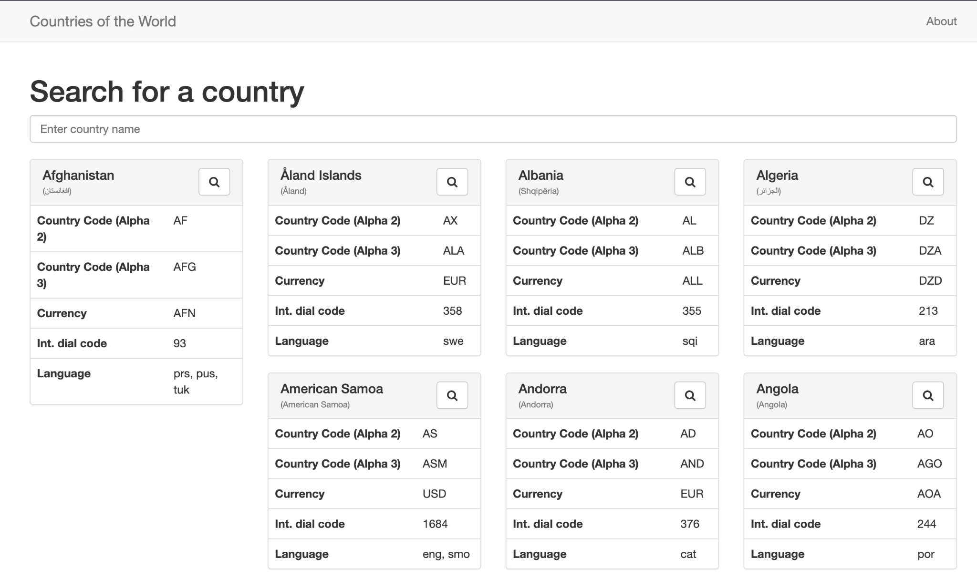

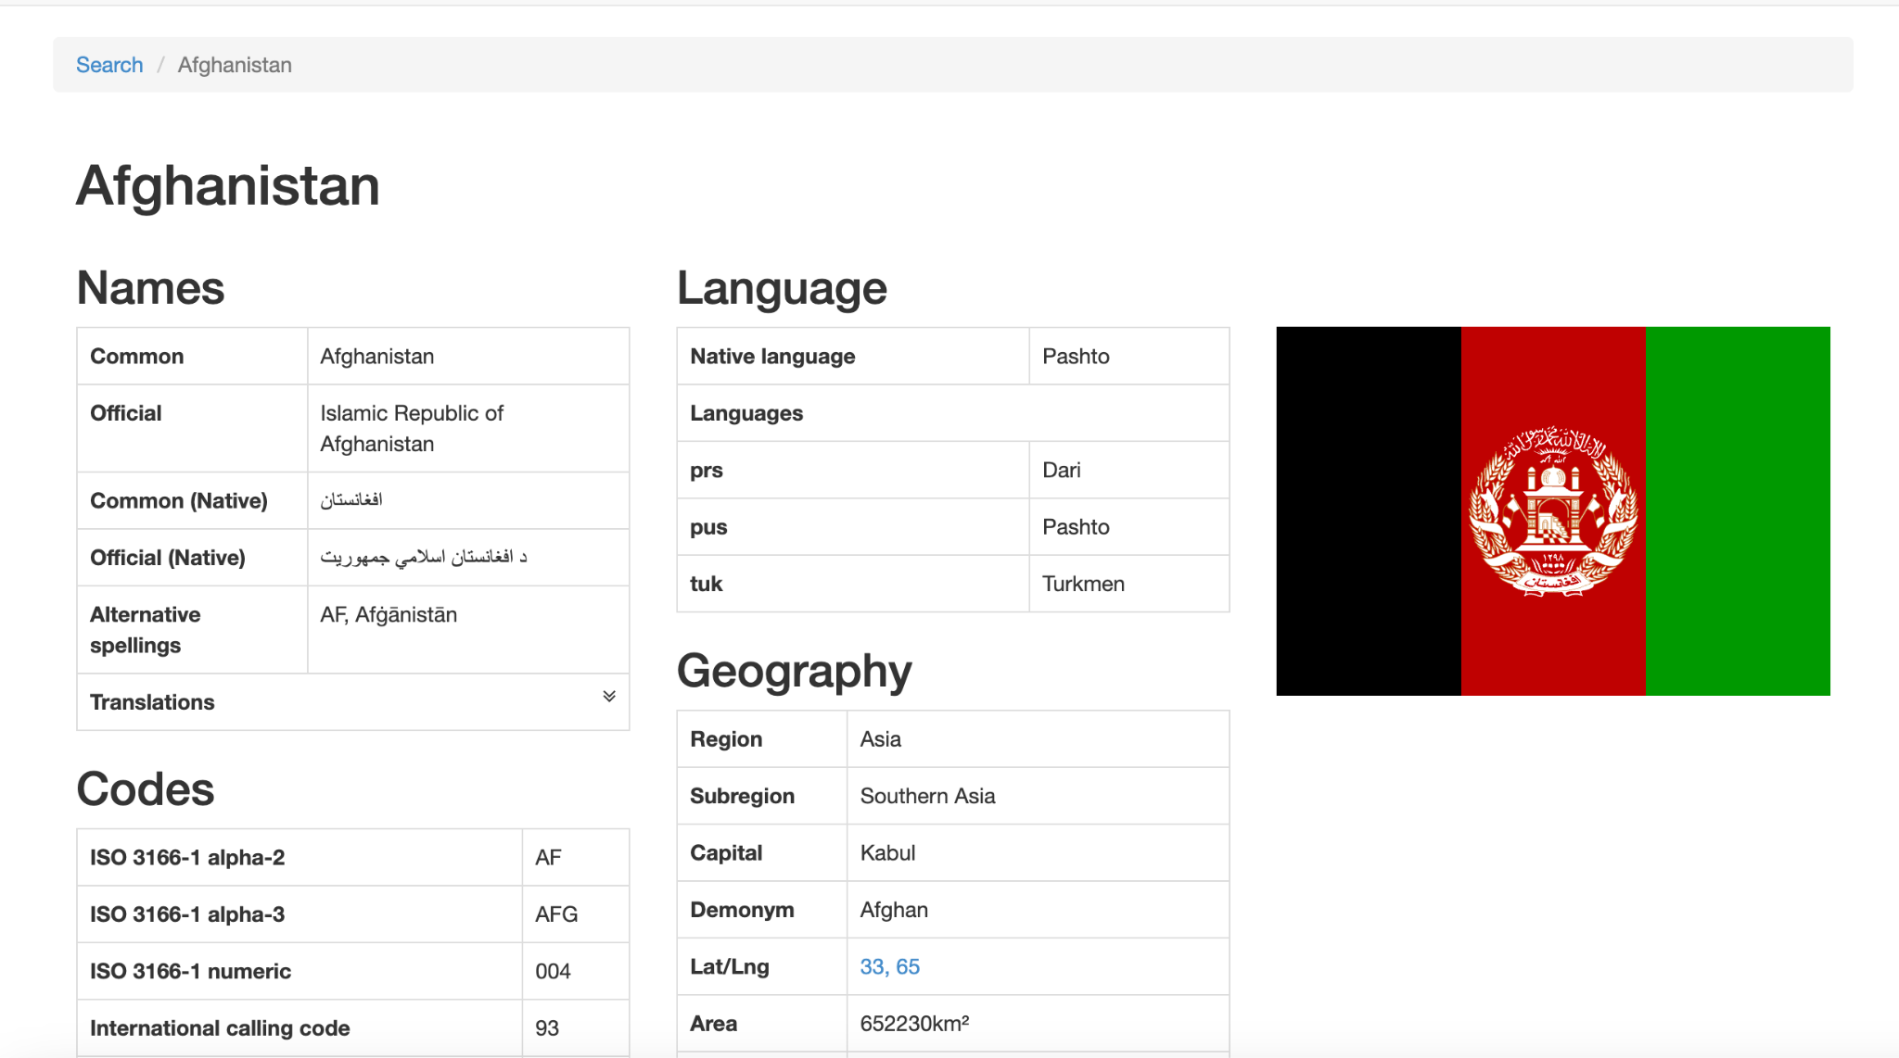
https://countries.petethompson.net/#/country/AFG
Notes:
MapKit to provide the world map in this application
REST API to provide all the countries information
Photo picker to achieve the functionality of changing the profile picture
Adjusting the colour asset for achieve the dark mode

Slide 13
05
Our Difficulties
Notes:
Demonstrate thoroughly how the app is used (2 marks)

Slide 14
Our Difficulties
How to Solve them
Struggle to fetch the data from the API
Struggle to pin the location in the map view
Do some research on YouTube and Google, StackOverFlow, …
See the sample from the teacher’s code on lab for the map

Slide 15
06
Demo Application
Using Xcode Application
Notes:
Demonstrate thoroughly how the app is used (2 marks)

